Slide 1



College Applications 101
a presentation by tony odhiambo

Slide 2

Agenda
1 | My Journey
2 | Personal Brand & Activities
3 | SAT & Recommendation Letters
4 | Choosing Schools
5 | Q & A

Slide 3

My Profile AT A GLANCE
Studied at Light Academy Nairobi (844), did KCSE 2023 (So yeah, I applied to uni and did KCSE in the same year)
Main passion: Mathematics
SAT: 1540
Was a very active student in and out of class
Other passions: Physics, Chemistry, Chess
Right now: AI/Machine Learning/Data Science
Joining MIT in a few weeks

Slide 4

My Journey
2020 - 2023

Slide 5

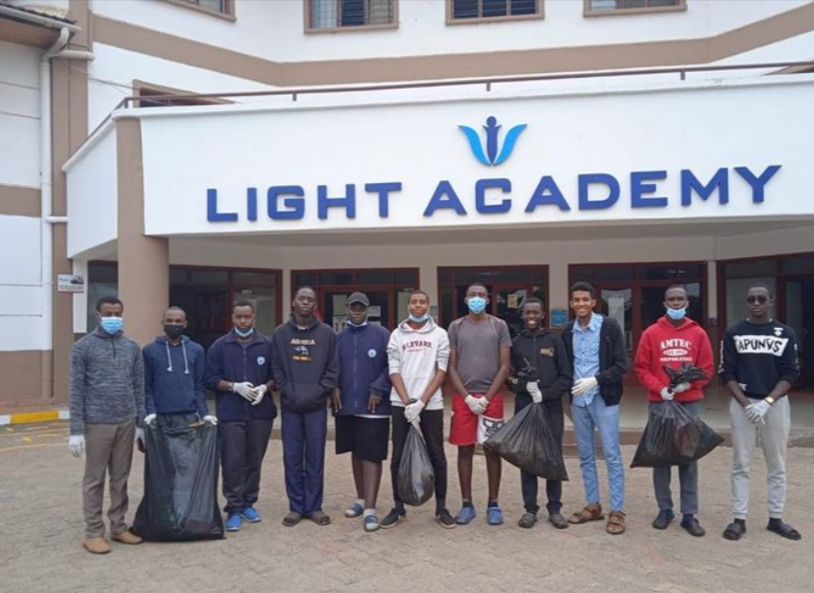
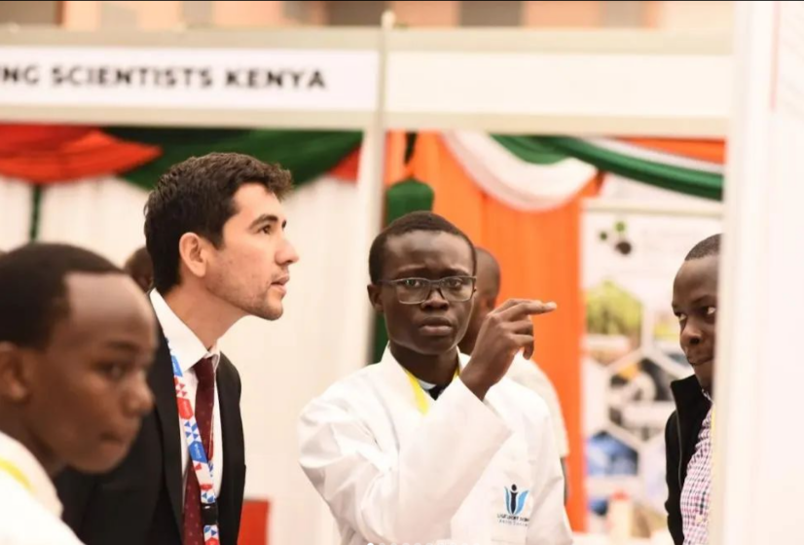

My Journey
2020
2021
2022
2023
Form 1 + Covid-19:
- Introspection
- Finding my passions
- Learned about USA universities, like MIT
Form 1/2:
- Establishing routines
- Reading ahead
- Began participating in competitions/clubs
Form 2/3: - Went all out with competitions, including:
Math Olympiads
Chess Tournaments
Volleyball
Science fairs/YSK
Debate
Form 3/4:
- Went global:
Rwanda (PAMO)
Japan (IMO)
Zimbabwe (YYAS)
Applications
SAT + KCSE
MIT EA

Slide 6

The Drive to pursue Global Opportunities Helped me stand out + Formed my Personal brand
in my college application

Slide 7

Personal Brand
How do you stand out
Specific demonstrated qualities (eg. Leadership, Creativity)
Your background (eg. Culture, Religion) or your ambitions
Combining your passions with purpose
In general, show how you have grown over time
Examples
Passionate in Business and Environment + Starts a business to sell items made from waste materials
Passionate in Art + Technology, Pursues Graphic design, posts on Social media
Passionate in French and Cooking + Shares French recipes, records cooking videos in French and posts online

Slide 8
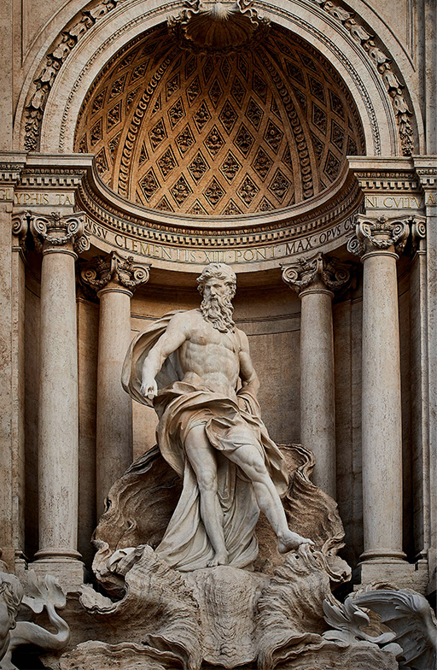
Activities
Come up with your activities list with your personal brand in mind
Have 10 Activities
Arrange from Most Important to Least Important
Be realistic with the Number of Hours and Weeks that you indicate
Use action verbs and add relevant statistics, for example
Raised Ksh. 25,000 for the purchase of 100 books…
Mentored 40 students…
Spearheaded 2 environmental campaigns, planted 450 trees…

Slide 9

Let the same ideas also show in your essays. 1. Personal Statement – Give New Information. Try and focus on things not mentioned in the rest of your app 2. Supplementary Essays – Focus on one aspect/activity at a time. - Use the space given to illustrate and show how your qualities/passions come into action. - DO LOTS OF RESEARCH (Especially Why Us and Why Major essays) and be intricate. Mention specific labs/professors/places in the school/school traditions - Show, Don’t tell. Instead of saying you “helped your community” be specific and go into detail, explaining how/why/when
Also use College Essay Guy

Slide 10
SAT

Slide 11

SAT Preparation
Do the SAT, many schools are no longer Test Optional like they were in the Covid era
Use Khan Academy Extensively, it has many topical questions for both Maths and English
Download Bluebook and do a few practice tests once in a while AND review your mistakes
Look up “Middle 50% SAT Score” for the school that you are applying to in order to set a reasonable target score.
Make the prep very regular, do not do it only 1 day a week. The more you practise, the better your speed and the higher your accuracy (if you review your mistakes)
You may do the SAT multiple times

Slide 12
Recommendation Letters

Slide 13

Recommendation Letters
Pick Recommenders Wisely
Look at your application and identify the 2 subject areas that are the most dominant. For example, Mathematics and History.
Apart from the Counsellor's and Teachers’ recommendations, you can get additional letters, it can be from another teacher, a sports coach, or a supervisor, or a mentor (Must not be related to you)
Content
The Counsellor’s Letter is general, should cover you in class and out of class, your strengths, your passions, your awards + WITH ILLUSTRATIONS
The other letters are more specific. Teacher’s Letters cover you and what you did in the subject, leadership roles you had etc. A coach’s letter would cover your performance in the game, leadership, teamwork etc.

Slide 14
How do you
Make a College List?
10 – 15 schools

Slide 15

FOCUS ON:
Need-Blind before Need Aware
2
Location
4
Some schools are right next to big cities hence more opportunities – Columbia, NYC
Some schools are in very cold places, others in warm places
Caltech, California – Warm
Colby, Maine - Cold
Put more emphasis on schools that do not take into account your financial status when making admissions decisions
Academic Programs Offered
3
Other Factors
5
Financial Aid
Not every school has certain majors, like Nuclear Engineering.
Also, different schools are better for different goals
MIT – Engineering
Yale - Language
Wharton (Upenn) - Business
Acceptance Rate (ED/RD)
Sports
Size of School
+ Give every application your best effort, just because a school has a high acceptance rate doesn’t mean that they have to accept you
1
Prioritize Schools that give larger (or ideally 100%) scholarship amounts+ international students. Also look out for schools with special scholarships
St Lawrence – Kenyan Scholarship

Slide 16
Conclusion
The Application is a place for you to tell your story, so use it well.
Do not be worried if you think that one part of the application is weaker than another, they review applications holistically. You can have a high SAT Score and put little effort into your activities -> It is unlikely that you will get in, compared to someone with a better activity list and a little lower SAT score.
If you are applying to a school Early (and you should) get to work and finish all the requirements ASAP. Time passes by very quickly and if you are not careful, you will spend many late nights doing last minute revisions on the deadline.

Slide 17

Thank You Q & A
Tony Odhiambo
tonyrotich2580@gmail.com
https://www.linkedin.com/in/tonyodhiambo/

